Slide 1




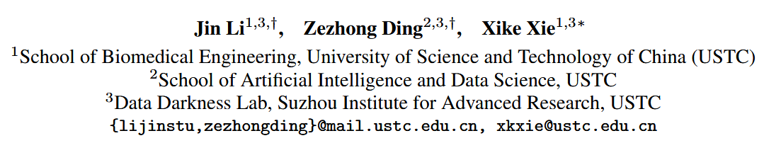



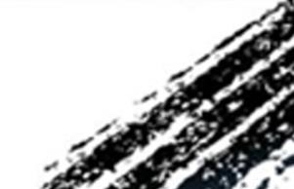

ATAI
Advanced Techniqueof Artificial Intelligence
ATAI
ChongqingUniversity _{AdvancedTechniqueof}
of Technology Artificial Intelligence
Chongqing University of
Technology
Chongqing University ^{ATAI}
_{of Technology} Advanced Techniqueof
Artificial Intelligence
Chongqing University of Technology
Chongqing University of Technology
  DuetGraph: Coarse-to-Fine Knowledge Graph Reasoning with Dual-Pathway Global-Local Fusion
2025.11.26•ChongQing
—— NeurlPS 2025
Reported by Yuming Yang
1
Notes:
多专家结构-语义混合框架用于揭示时序知识图谱的历史模式

Slide 2

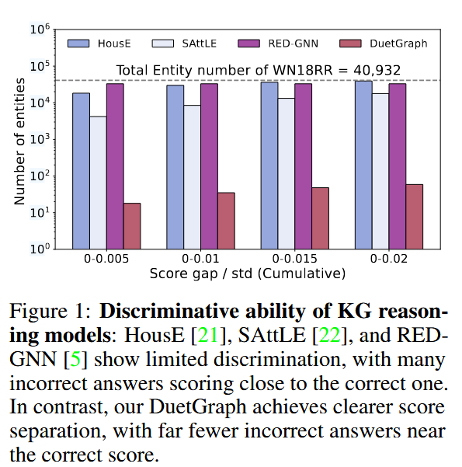
ATAI
AdvancedTechniqueof
Artificial Intelligence
ATAI
ChongqingUniversity _{AdvancedTechniqueof}
of Technology Artificial Intelligence
ChongqingUniversity of Technology
Motivation
1)Existing studies have shown that stacking either messagepassing or attention layers individually deepens information propagation and aggravates the over-smoothing problem. When messagepassing and attention layers are stacked together, these effects accumulate.
2)The discriminative capacity of single stage models is typically limited, as they generate the answer directly based on a one-shot reasoning. This deficiency in discrimination further exacerbates the over-smoothing phenomenon.
Notes:
1.现有的工作要么集中在结构信息，要么集中在语义信息，忽视了整合这两种信息的潜在好处
2.这些方法忽略了在处理不同类型的事件时，不同类型的信息有其自身的优势。对于历史事件，捕获重复模式，而对于非历史事件，探索进化模式。
结构信息的缺乏导致对实体交互模式的认识不足，而语义信息的缺乏则阻碍了对实体行为的理解。如图1(b)所示，法国反复出现的“控诉”或“需求”行动可以为预测未来的“需求”行动提供信息。从“控诉”到“要求”有一个逻辑进程，但基于图形的方法只是将它们视为两个不同的关系，失去了这种推理证据
结构信息和语义信息在应用于不同类型事件时的互补优势
历史事件通常涉及复杂的背景，大型语言模型可以更好地捕捉这些背景

Slide 3

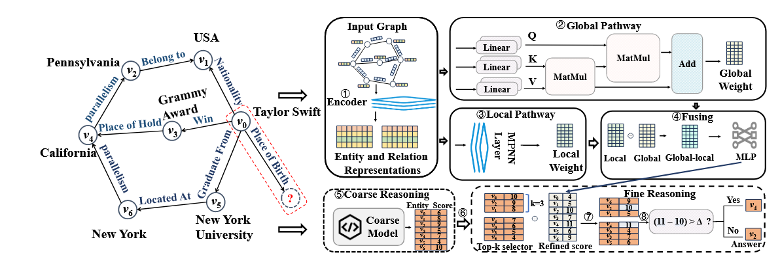
ChongqingUniversity of Technology
ATAI
AdvancedTechniqueof
Artificial Intelligence
ATAI
ChongqingUniversity _{AdvancedTechniqueof}
of Technology Artificial Intelligence
Overview
Notes:
三层架构：特征编码器 → 事件感知专家（多专家）→ 预测专家。底层并行抽取结构与语义两种视角的查询表示，中层用“历史/非历史”两类专家模块带门控完成自适应融合，顶层再用一个预测专家对所有专家输出二次加权，产出最终查询表示并打分候选实体
基于gcn的结构编码器，以子图作为输入;一个基于llm的语义编码器，以实体/关系名称作为输入。
设 M个历史专家与 N个非历史专家。每个专家有一个查询驱动的门控，以 qg​ 为输入产生权重 αi，再在结构与语义两路之间做按权融合
历史专家（i=1）：αi​较小（依赖语义信息更多），因历史事件需捕捉 “重复语义模式”（如 Accuse→Demand）；
非历史专家（i=2）：αi​较大（依赖结构信息更多），因非历史事件需捕捉 “结构演化模式”（如 France 与新实体的潜在连接）。

Slide 4

ChongqingUniversity of Technology
ATAI
AdvancedTechniqueof
Artificial Intelligence
ATAI
ChongqingUniversity _{AdvancedTechniqueof}
of Technology Artificial Intelligence
Method

Slide 5

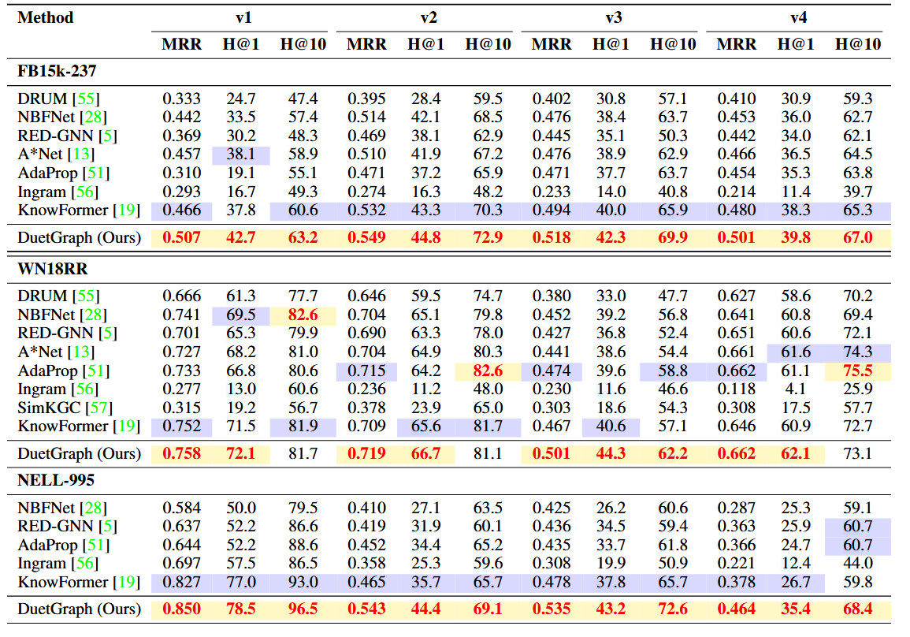
ATAI
AdvancedTechniqueof
Artificial Intelligence
ATAI
ChongqingUniversity _{AdvancedTechniqueof}
of Technology Artificial Intelligence
ChongqingUniversity of Technology
Experiments

Slide 6
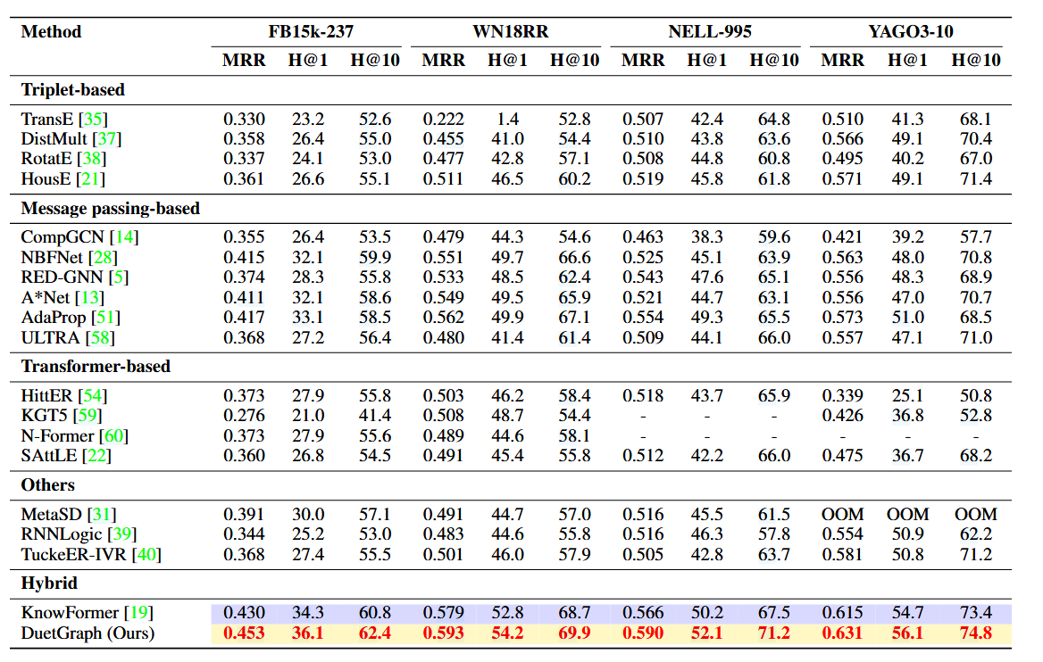
ATAI
AdvancedTechniqueof
Artificial Intelligence
ATAI
ChongqingUniversity _{AdvancedTechniqueof}
of Technology Artificial Intelligence
ChongqingUniversity of Technology
Experiments

Slide 7
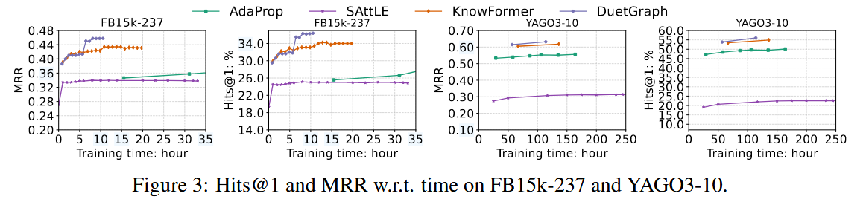
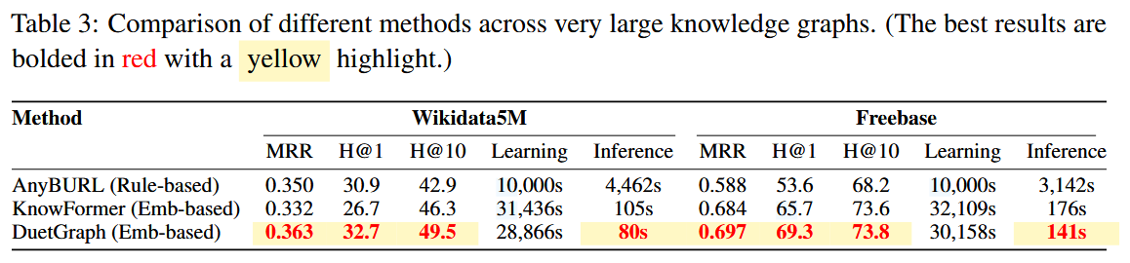
ATAI
AdvancedTechniqueof
Artificial Intelligence
ATAI
ChongqingUniversity _{AdvancedTechniqueof}
of Technology Artificial Intelligence
ChongqingUniversity of Technology
Experiments

Slide 8
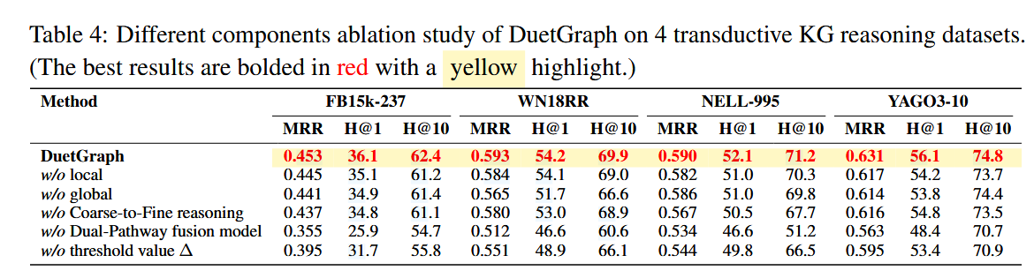
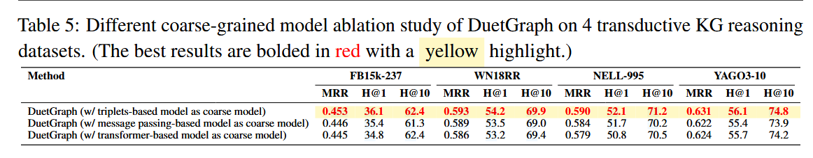
ATAI
AdvancedTechniqueof
Artificial Intelligence
ATAI
ChongqingUniversity _{AdvancedTechniqueof}
of Technology Artificial Intelligence
ChongqingUniversity of Technology
Experiments

Slide 9
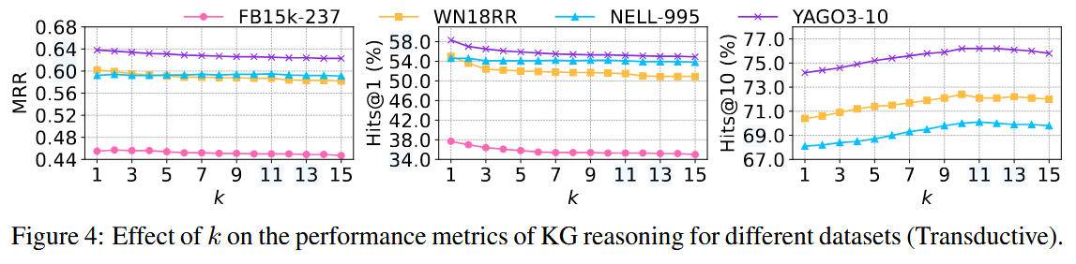
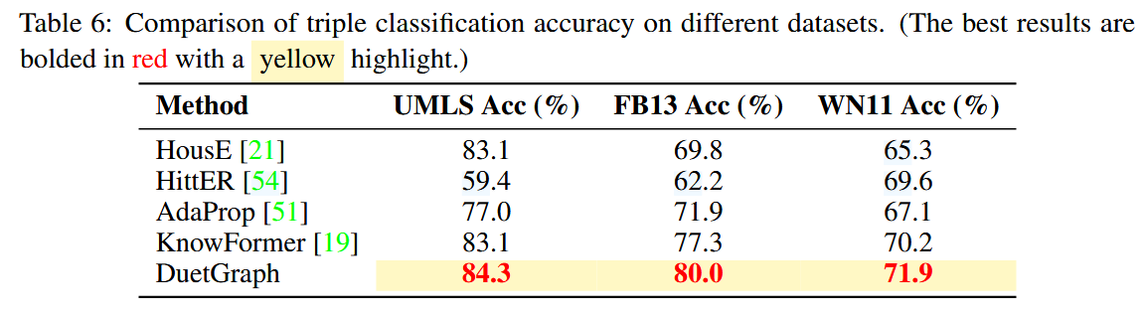
ATAI
AdvancedTechniqueof
Artificial Intelligence
ATAI
ChongqingUniversity _{AdvancedTechniqueof}
of Technology Artificial Intelligence
ChongqingUniversity of Technology
Experiments

Slide 10


ChongqingUniversity of Technology
ATAI
AdvancedTechniqueof
Artificial Intelligence
ATAI
ChongqingUniversity _{AdvancedTechniqueof}
of Technology Artificial Intelligence
Thanks!

